Slide 1
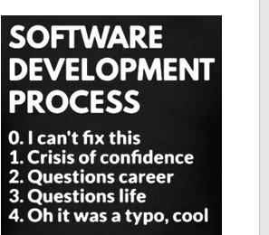
Goals for today
Understand how history of hardware connects to how we store data
Know how to calculate binary numbers
Understand why we have data types

Slide 2
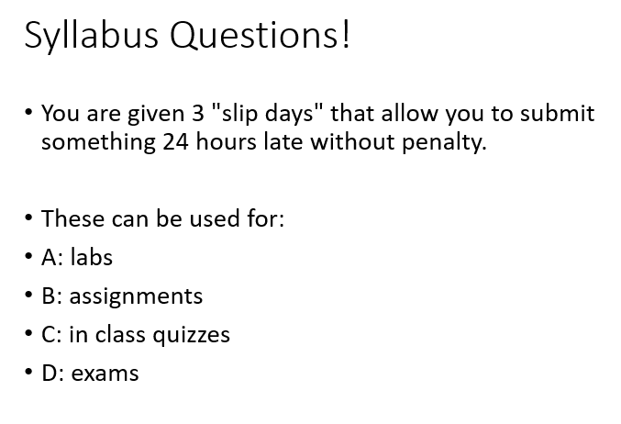

Slide 3
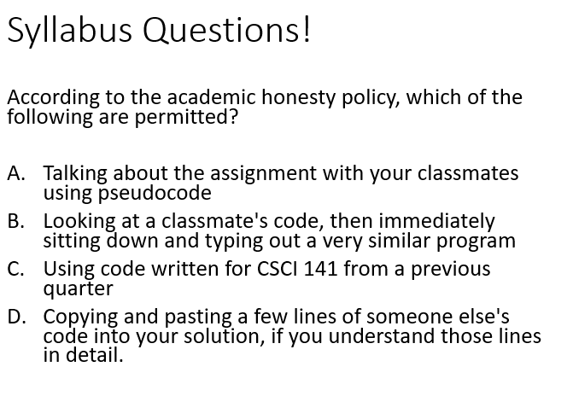

Slide 4
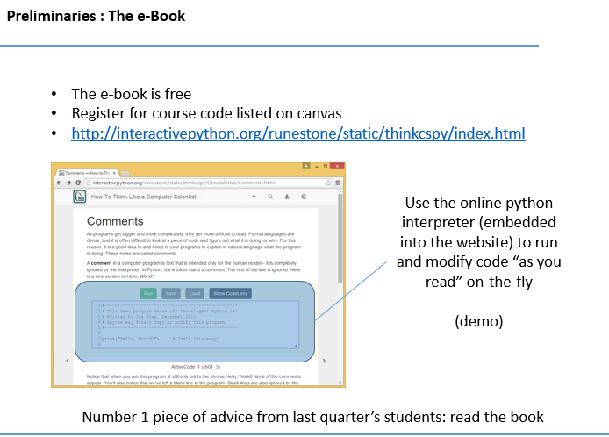

Slide 5
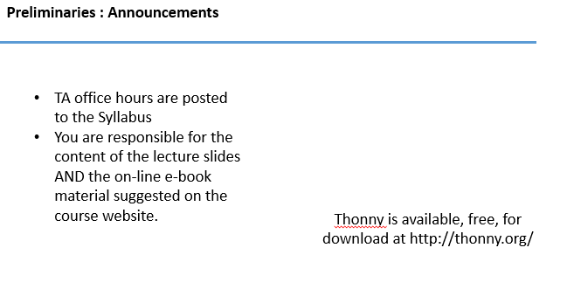

Slide 6
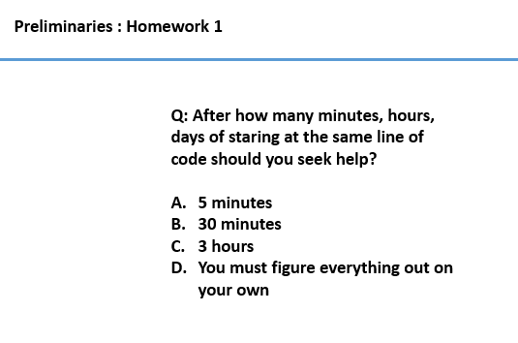

Slide 7
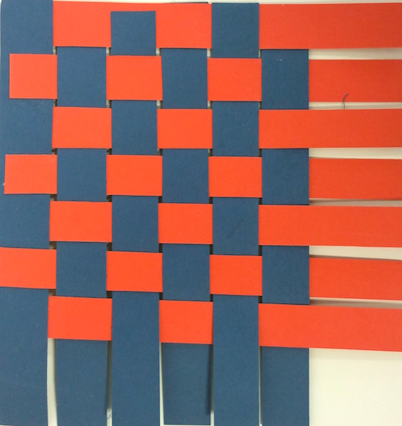

Slide 8
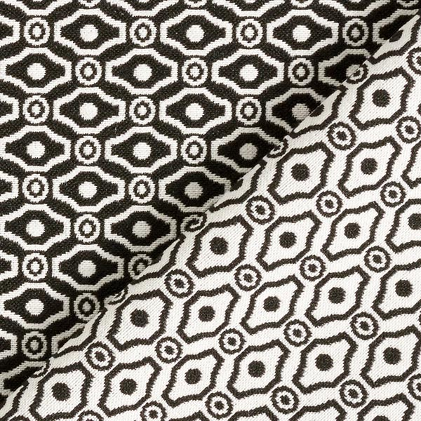
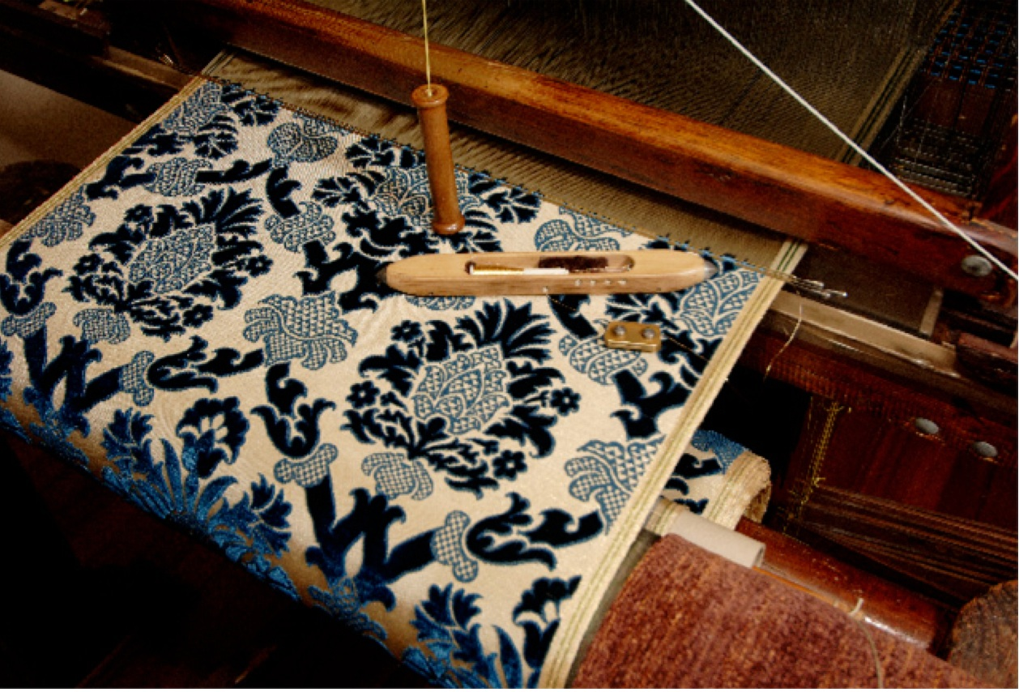

Slide 9
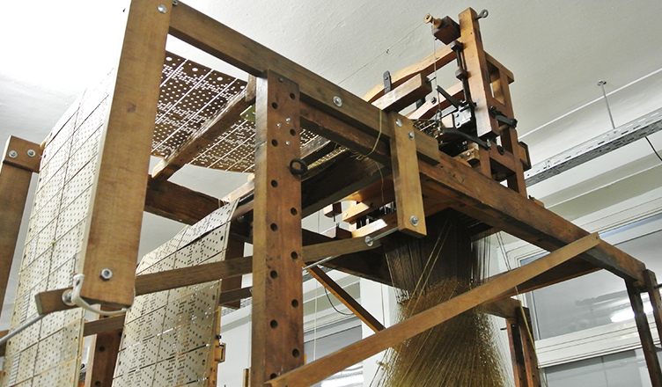

Slide 10
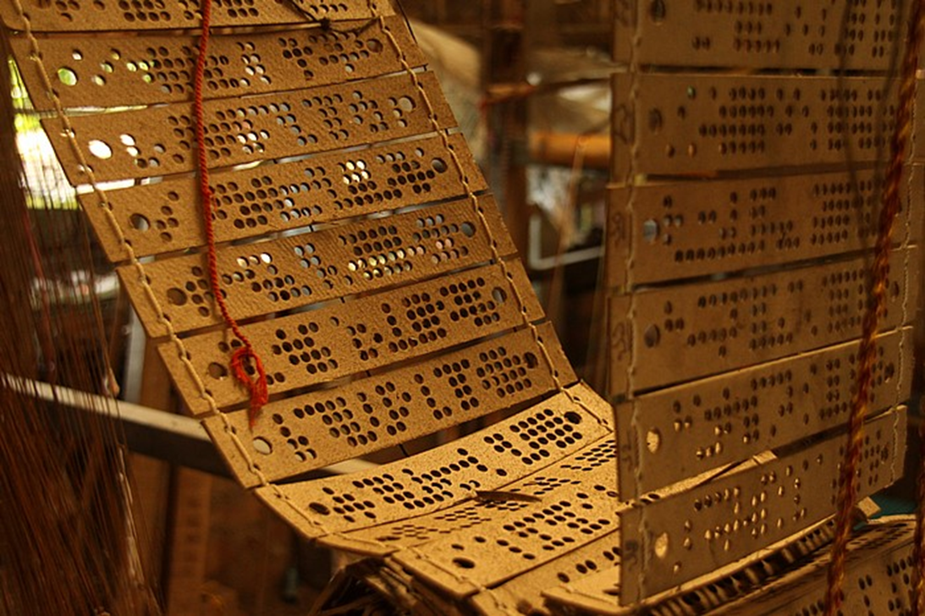
Punchcard looms

Slide 11
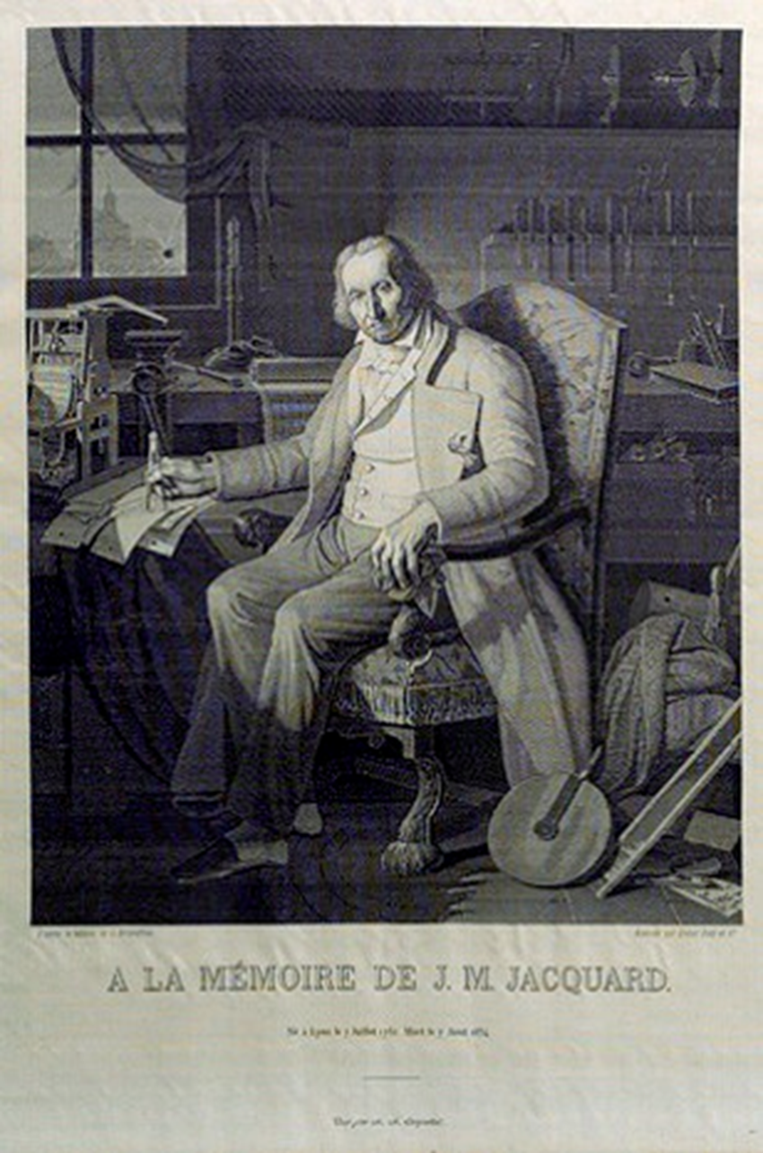
Jacquard 1804
Notes:
“This portrait of Jacquard was woven in silk on a Jacquard loom and required 24,000 punched cards to create (1839). It was only produced to order. Charles Babbage owned one of these portraits ; it inspired him in using perforated cards in his analytical engine” Wikipedia, Sept 2011

Slide 12
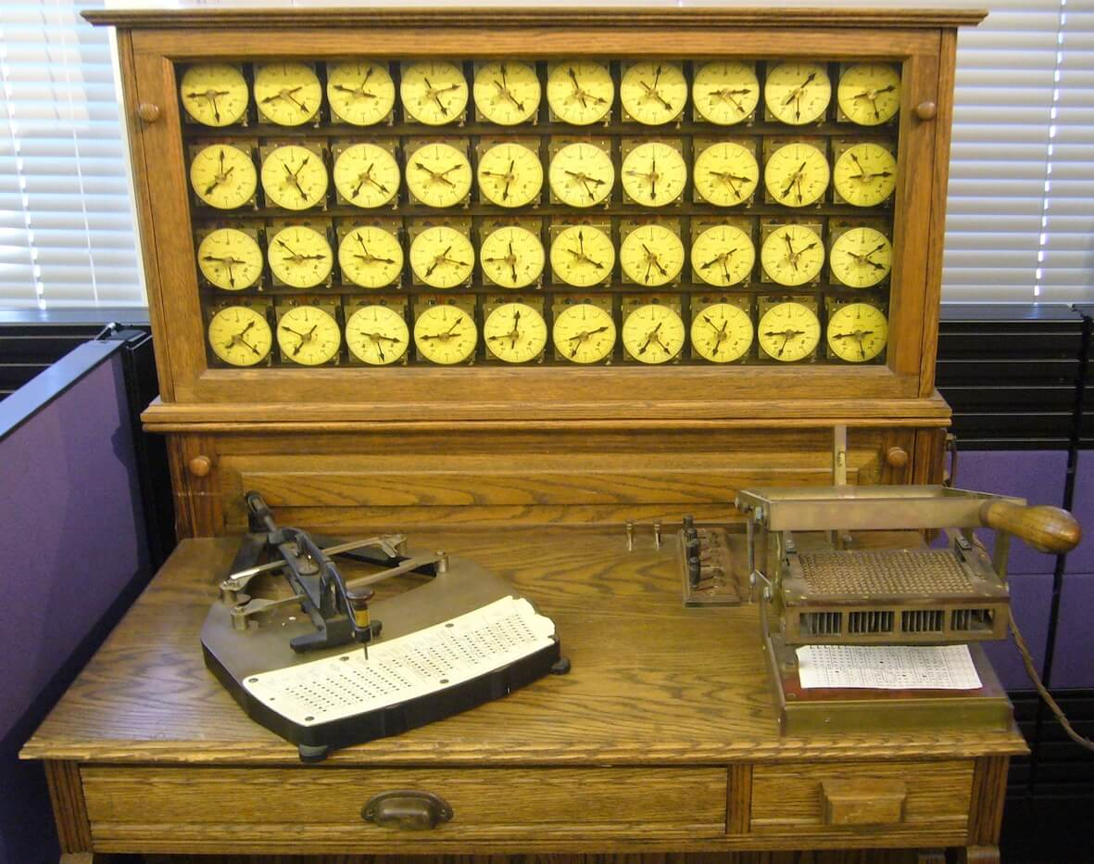
Notes:
Dr. Herman Hollerith built the first electrically-driven processing machine in order to accommodate the 1890 census. This machine used punched cards, not unlike those used until the late 70’s. Hollerith’s company eventually changed its name to International Business Machines…

Slide 13
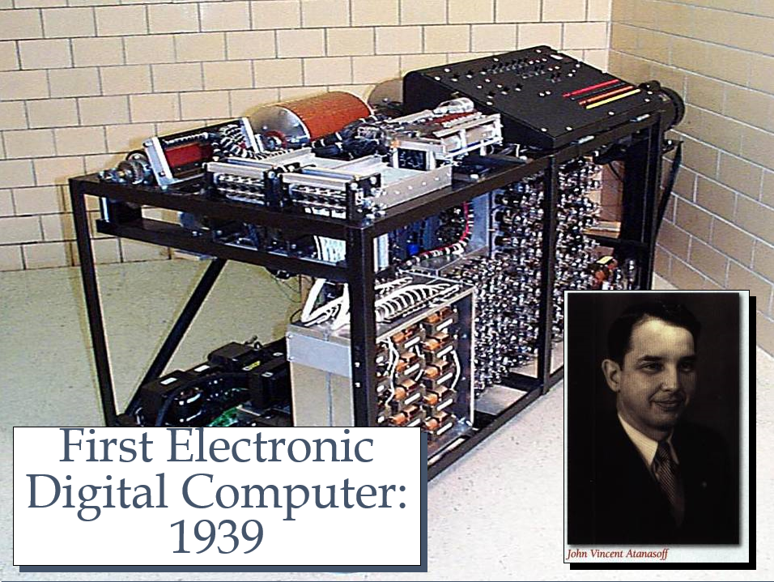
Notes:
The first digital electronic computer was at Iowa State University, between 1939 and 1942, and was led by John Atanasoff and a graduate student.
This machine had many firsts, including binary arithmetic, parallel processing, regenerative memory, separate memory and computer functions, just to mention a few. When completed, it weighed 750 pounds and could store a whopping 3,000 bytes of data. Called the ABC (Atanasoff – Berry Computer), it was partially disassembled to make room for other projects when John Atanasoff went to the Navy during World War II.
The technology developed for the ABC machine passed from Atanasoff to John W. Mauchly, who is responsible for the first large-scale digital electronic computer. The photo shown here is a working reproduction.

Slide 14
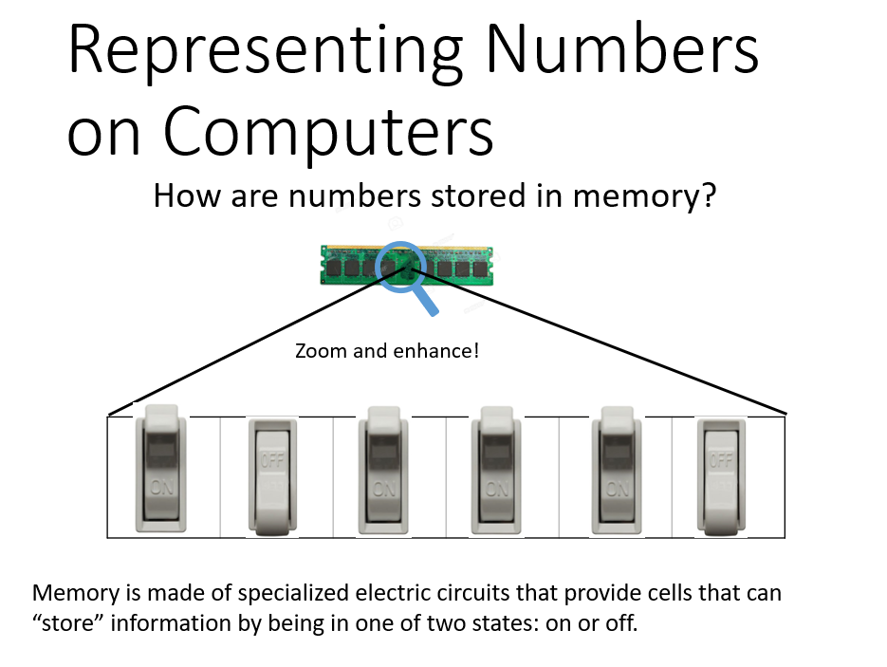

Slide 15
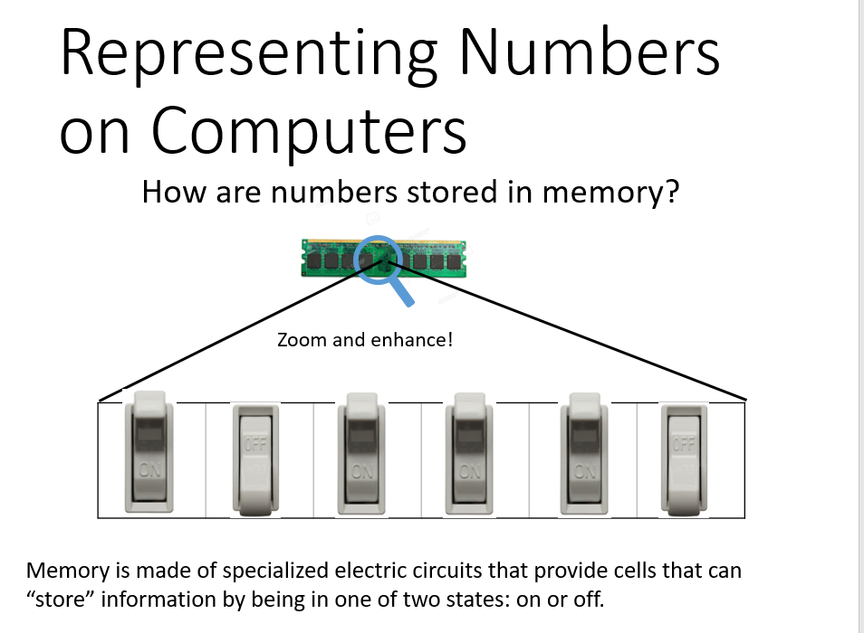

Slide 16
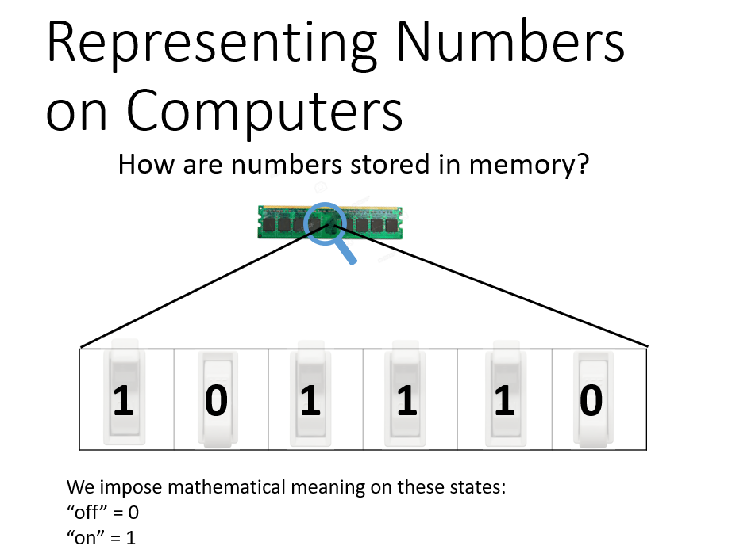

Slide 17
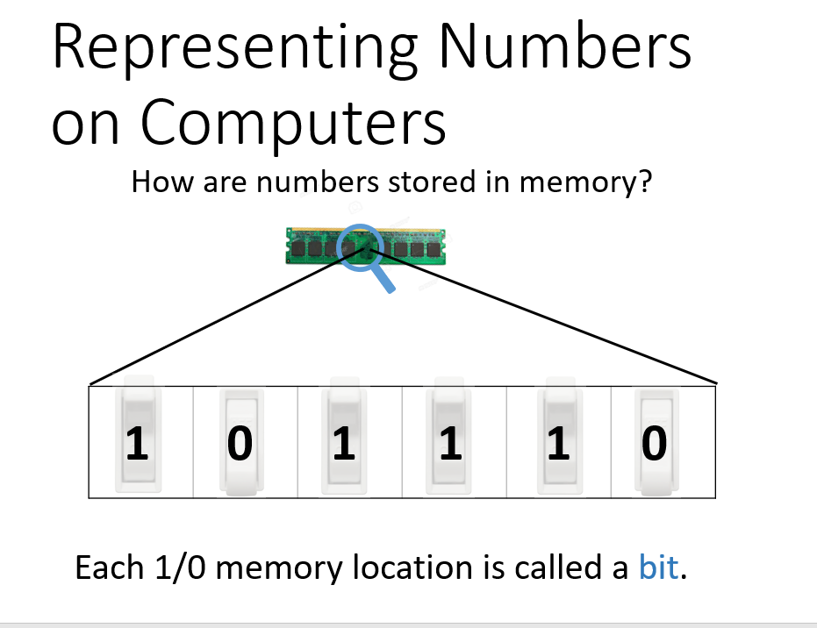

Slide 18
